Slide 1
Silverlight and SharePoint
Jake Adams
Thompson Coburn LLP

Slide 2
Overview
Silverlight background
Pro and cons of using Silverlight with SharePoint
Getting Started with Silverlight web parts inside of SharePoint
How to interact with SharePoint data using Silverlight
More advanced examples and demos

Slide 3
Sponsors

Slide 4
About Me
Jake Adams
Thompson Coburn LLP
email: jacobladams@gmail.com
twitter: @jacobladams
geekswithblogs.com/jacobladams
github.com/jacobladams
speakerrate.com/jacobladams

Slide 5
Silverlight
Originally codenamed WPF/Everywhere
V1 released in 2007
Cross-browser, cross-platform application framework
Originally intended for building RIAs (Rich-internet applications)

Slide 6


Silverlight + SharePoint = ?

Slide 7
Silverlight + SharePoint == Goodness
Runs on the client
Reduces server resources
More responsive / Better UX
Reduces post backs

Slide 8

Silverlight + SharePoint == Goodness
Graphically-rich development stack
(draws pretty pictures)
Vector graphics
Control templating
Intelligent layout system
3D Engine

Slide 9
Silverlight + SharePoint == Goodness
Powerful data binding capabilities

Slide 10

Silverlight + SharePoint == Goodness
Runs on .NET

Slide 11
Silverlight + SharePoint == Goodness
Can be developed outside of SharePoint
Doesn’t require SharePoint to be installed.
Makes testing easier
Easier deployment
Can be deployed outside of SharePoint

Slide 12
Silverlight + SharePoint != Goodness
Plugin required
75% of all browsers have Silverlight installed
0% of mobile browsers have Silverlight

Slide 13

Silverlight + SharePoint != Goodness
Future of Silverlight is uncertain
Microsoft may be shifting focus towards HTML5

Slide 14
Demos

Slide 15


Getting Started
Compile Silverlight application into XAP file
Put XAP file somewhere that SharePoint can access it.
I prefer using a separate document library.
Add Silverlight web part to a page.
Reference XAP file in web part.
4a) Pass in configuration parameters if necessary.
Sip Piña coladas on the beach.

Slide 16
Accessing SharePoint From Silverlight
Client Object Model
SharePoint Web Services
OData API
Silverlight/JavaScript Bridge
Custom Web Services

Slide 17
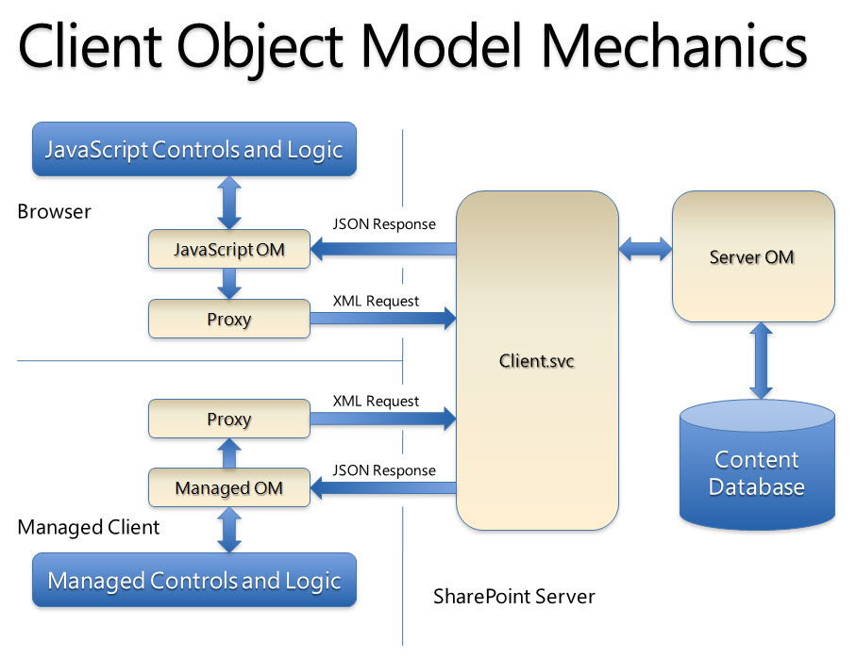
Silverlight Client Object Model

Slide 18
Links
MSDN
http://www.componentart.com/community/competition2009/contestants.aspx
http://www.silverlight.net/showcase
http://www.noupe.com/showcases/50-interactive-silverlight-applications.html

Slide 19
Recap
email: jacobladams@gmail.com
twitter: @jacobladams
github.com
speakerrate.com

